Slide 1
Capstone Project - The Battle of Neighborhoods- New York City

Slide 2
Introduction
Throughout its history, New York City has been a major point of entry for immigrants; the term "melting pot" was coined to describe densely populated immigrant neighborhoods on the Lower East Side. As many as 800 languages are spoken in New York, making it the most linguistically diverse city in the world. English remains the most widely spoken language, although there are areas in the outer boroughs in which up to 25% of people speak English as an alternate language, and/or have limited or no English language fluency. English is least spoken in neighborhoods such as Flushing, Sunset Park, and Corona.
With it's diverse culture , comes diverse food items. There are many restaurants in New York City, each belonging to different categories like Chinese , Indian , French etc.
So as part of this project , we will list and visualize all major parts of New York City that has great Indian restaurants.

Slide 6
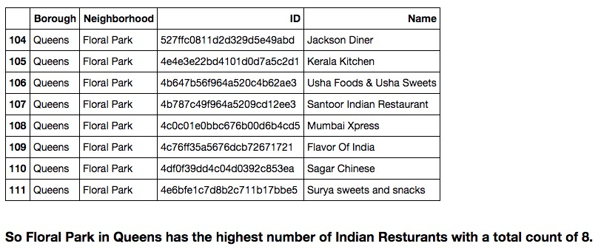

Slide 7
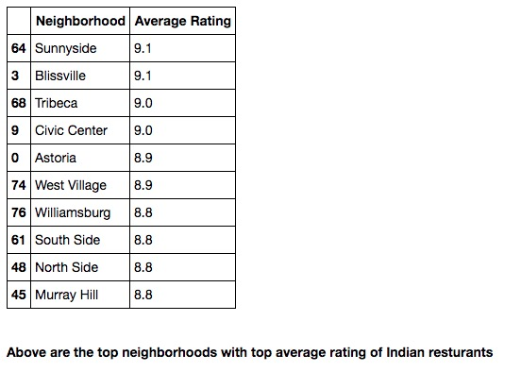

Slide 9
Conclusion
Astoria(Queens), Blissville(Queens), Civic Center(Manhattan) are some of the best neighborhoods for Indian cuisine. Manhattan have potential Indian Restaurant Market/ Staten Island ranks last in average rating of Indian Restaurants. Manhattan is the best place to stay if you prefer Indian Cuisine.
Limitations
The ranking is purely on basis of rating of restaurants The accuracy of data depends purely depends on the data provided by FourSquare

